Slide 1
23.02.2022 Presentation

Slide 2
BlazePose: A lightweight convolutional neural network architecture for human pose estimation that is tailored for real-time inference on mobile device.
Classifier Algorithm: k-nn (k-nearest neighbors) algorithm.

Slide 3
Transform Samples Into a K-NN Classifier Training Set
Pose Classification (Basic): https://colab.research.google.com/drive/1z4IM8kG6ipHN6keadjD-F6vMiIIgViKK
Pose Classification (Extended):
https://colab.research.google.com/drive/19txHpN8exWhstO6WVkfmYYVC6uug_oVR#scrollTo=vL2VrLjtHZCs

Slide 4
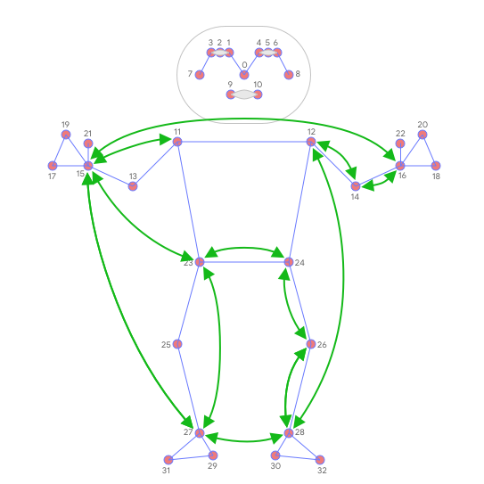
For conversion all poses are normalized to have the same torso size and vertical torso orientation.
Pairwise distances between predefined pose joints:

Slide 5
For oPtımızıng
K-NN search is invoked twice with different distance metrics:
First, to filter out samples that are almost the same as the target one but have only a few different values in the feature vector (which means differently bent joints and thus other pose class), minimum per-coordinate distance is used as distance metric,
Then average per-coordinate distance is used to find the nearest pose cluster among those from the first search.

Slide 6
Final Step
Finally, it was applied exponential moving average (EMA) smoothing to level any noise from pose prediction or classification. To do that, it was searched not only for the nearest pose cluster, but it calculated a probability for each of them and use it for smoothing over time.

